Slide 1
Introduction to Web Page Design
Unit 1
© All 4 Computer Science
Designed by Freepik

Slide 2
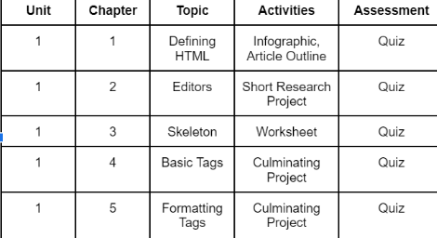
Table of Contents
© All 4 Computer Science
CPU
Designed by Freepik

Slide 3
Chapter 1
Defining HTML
© All 4 Computer Science
Designed by Freepik

Slide 4
Learning Targets
►
I can elaborate on the origins of HTML.
Defining HTML
►
I can define HTML.
►
I can explain the advantages of HTML.
© All 4 Computer Science
Designed by Freepik

Slide 5
What is HTML?
HTML stands for Hypertext Markup Language. It is used to create web pages and make them more functional.
© All 4 Computer Science
Designed by Freepik

Slide 6
Who invented HTML?
Tim Berners-Lee invented HTML 1.0 in 1990.
He later releases HTML 1.0 in 1993.
By 1999 HTML version 4.0 becomes the industry standard.
© All 4 Computer Science
CPU
Designed by Freepik

Slide 7
Why was HTML invented?
To allow researchers from around the world to work together.
© All 4 Computer Science
CPU
Designed by Freepik

Slide 8
What are the advantages of HTML?
Helps to create responsive designs
Helps to develop games
Helps to create offline web applications
© All 4 Computer Science
CPU
Designed by Freepik

Slide 9
Infographic Activity
Instructions: Select 3-5 facts from this chapter and create an infographic using those facts. After the students have completed this, have them share their infographic with the class. In the end, the students should conclude with what new or interesting information that they learned.
Example:
https://venngage.com/blog/what-is-an-infographic/
© All 4 Computer Science
CPU
Designed by Freepik

Slide 10
Article Outline
If time permits have the students further their knowledge by outlining and discussing a relevant article chosen by the instructor. Students can use one of the “Article Outline” Worksheets to complete this.
https://medium.com/@ost18604/the-importance-of-html-and-css-in-developing-a-website-40f2783de1d5
https://bootcamp.berkeley.edu/resources/coding/learn-html/
© All 4 Computer Science
CPU
Designed by Freepik

Slide 11
Chapter Quiz
Please complete your Chapter Quiz.
© All 4 Computer Science
Designed by Freepik

